Slide 1
GitHub & sourcetree
Hands on study
Organized by Jaden Ahn
emailtojaden@gmail.com

Slide 2
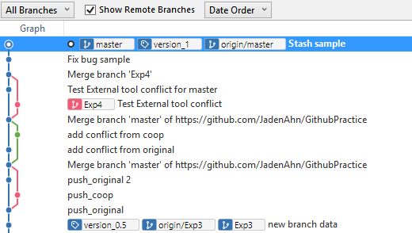
Why do we need Git & Sourcetree?
Manage versions
Branch
Reset / Reverse
Merge
Collaborate
Resolve conflict

Slide 3
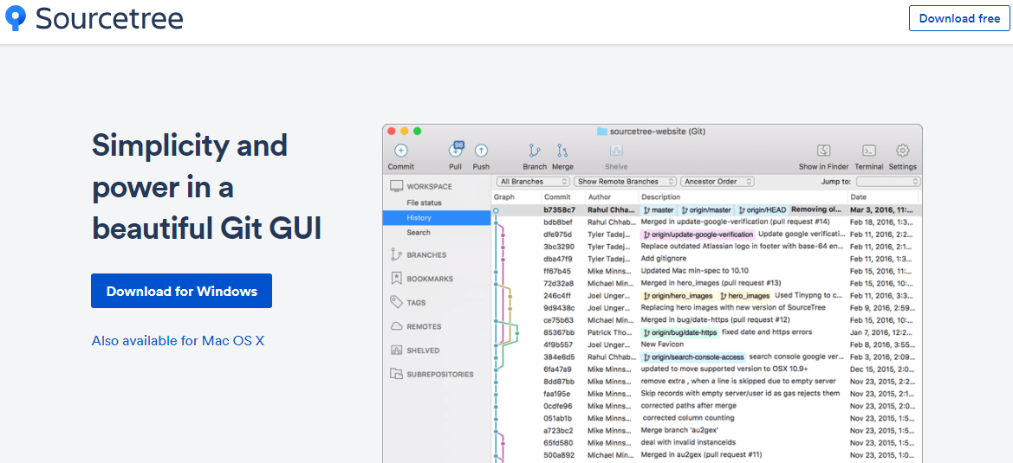
Install Sourcetree
https://www.sourcetreeapp.com/

Slide 4
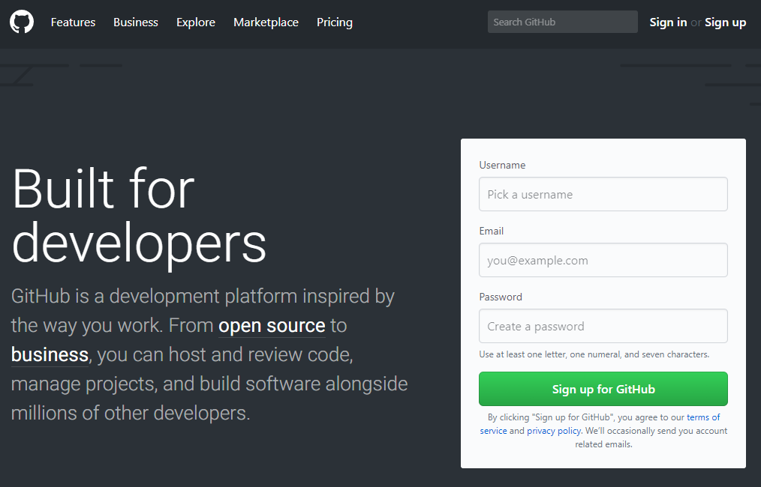
Create GitHub Account
https://github.com/

Slide 5
Create Repository
Create a repository on GitHub
Clone

Slide 6
Commit
Create a sample html file
Add one line
Add comment then commit

Slide 7
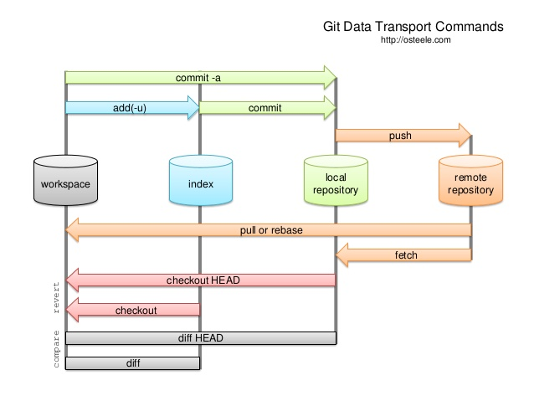
workspace, Index, Repository

Slide 8
Push & Pull
Push & Pull = synchronizing with remote repository
Push = upload
Pull = download
This process is important when collaborating

Slide 9
Commit Practice
Make a blank html file
Commit the file
Add lines
Booked Usual Suspect, then commit
Read an article, "Who Is Keyser Söze" , then commit
Purchased pop corn , then commit
Got my ticket , then commit
Watched the movie , then commit

Slide 10
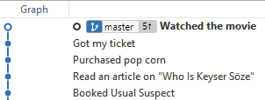

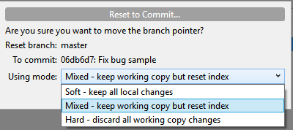
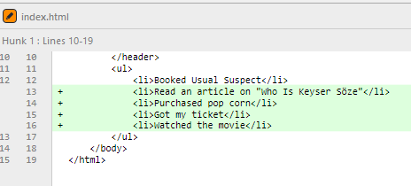
Reset vs. Revert
Reset: Clear history
Mixed: reset, save changes to Unstaged(recommended, default)
Soft: reset, save changes to Staged
Hard: reset, discard all change history
[Changes]

Slide 11
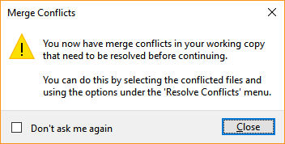
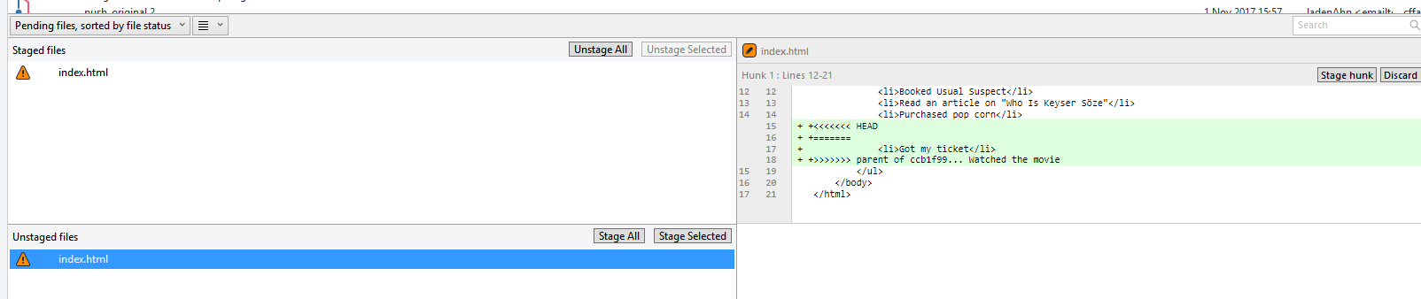
Reset vs. Revert
Revert: Restore previous version
Chances of conflict when not done one by one

Slide 12
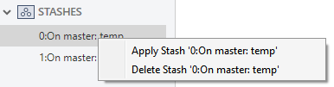
Branch
Making a branch
Origin/master : remote repository
Master: local repository
Merge a branch to the master branch
How to resolve conflict
Check all the code before merge
Do not commit not-working code
You can use Stash to save temporary work, then apply later

Slide 13
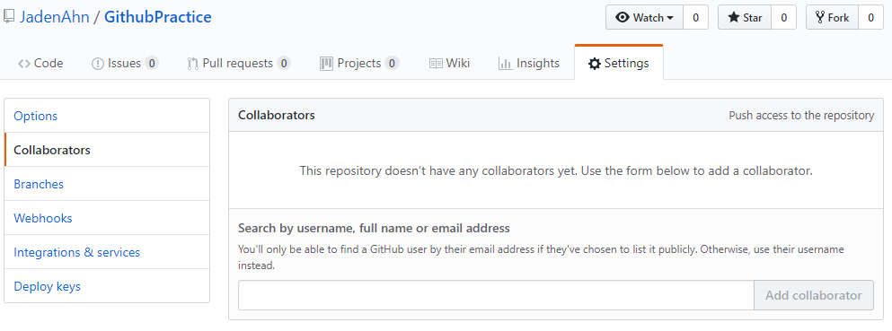
Collaboration
Add collaborators

Slide 14
Collaboration
PULL
WORK
COMMIT
PULL
PUSH
Resolve conflicts
How to reduce chances of conflicts
Who is responsible for conflict?
The one who committed later

Slide 15
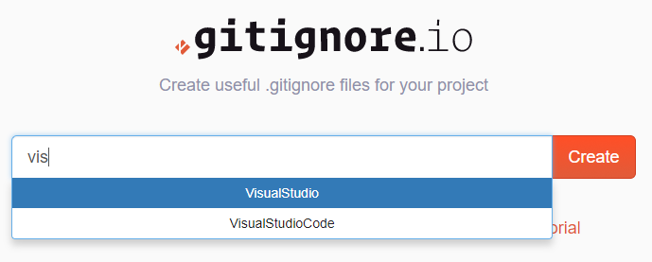
.gitignore
You can ignore certain files
When you ignore some files, .gitignore file is created
You can manually make this file by saving a txt file with the name “.gitignore.”
You can generate list to ignore
https://www.gitignore.io/
Ignore config files holding
confidential information

